Slide 1
Html + css +javascript git

Slide 2
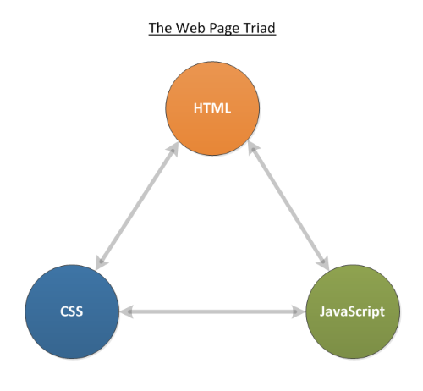
triangle

Slide 3
What is html ?
HTML IS A MARKUP LANGUAGE THAT WE USE TO STRUCTURE AND GIVE MEANING TO OUR WEB CONTENT
ALL THE TEXT WE SEE ON THE WEB IS DONE WITH HTML
<h1>, <li>, <a>, <p>

Slide 4
CASCADING STYLE SHEET
IS THE LANGUAGE OF STYLE RULES THAT WE USE TO APPLY
THE CASCADING MEANS THAT A STYLE APPLIED TO A PARENT ELEMENT WILL ALSO APPLY TO THE CHILD ELEMENTS WITHIN THE
THERE ARE THREE WAY TO INCLUD A STYLE SHEET TO THE HTML

Slide 5
INLINE STYLE
<p style = “color: red;”>Some text</p>

Slide 6
WITHIN THE HTML HEADER:
<head>
<style type=“text/css”>
h1 {
color: red;
}
<style>
</head>

Slide 7
External style sheet
body {
background-color: #000080;
}
<head>
<link rel=“stylesheet” type=“text/css” href=“style.css” tytle=“style”>
</head>

Slide 8
Javascript
JS IS A SCRIPTING LANGUAGE THAT ENABLES US TO CREATE DYNAMICALLY UPDATING CONTENT, CONTROL MULTIMEDIA, ANIMATE IMAGES.
SOME EXAMPLES: WE CAN DECLARE VARIABLES, IF STATEMENTS, FOR & WHILE LOOPS

Slide 9
git
IT’S A VERSION CONTROL SYSYTEM WHICH HELPS FOR COMPANYS AND ORGANIZATIONS TO WORK WITH MANY PEOPLE ON THE SAME PROJECT AND THEN PUSH IT TO THE CLOUD
ANYTIME CAN BE CHANGED AND CAN BE ROLL BACK TO ANY OF IT’S PREVIOUS STATE

Slide 10
THANKS FOR YOUR ATTENTION

